Slide 1
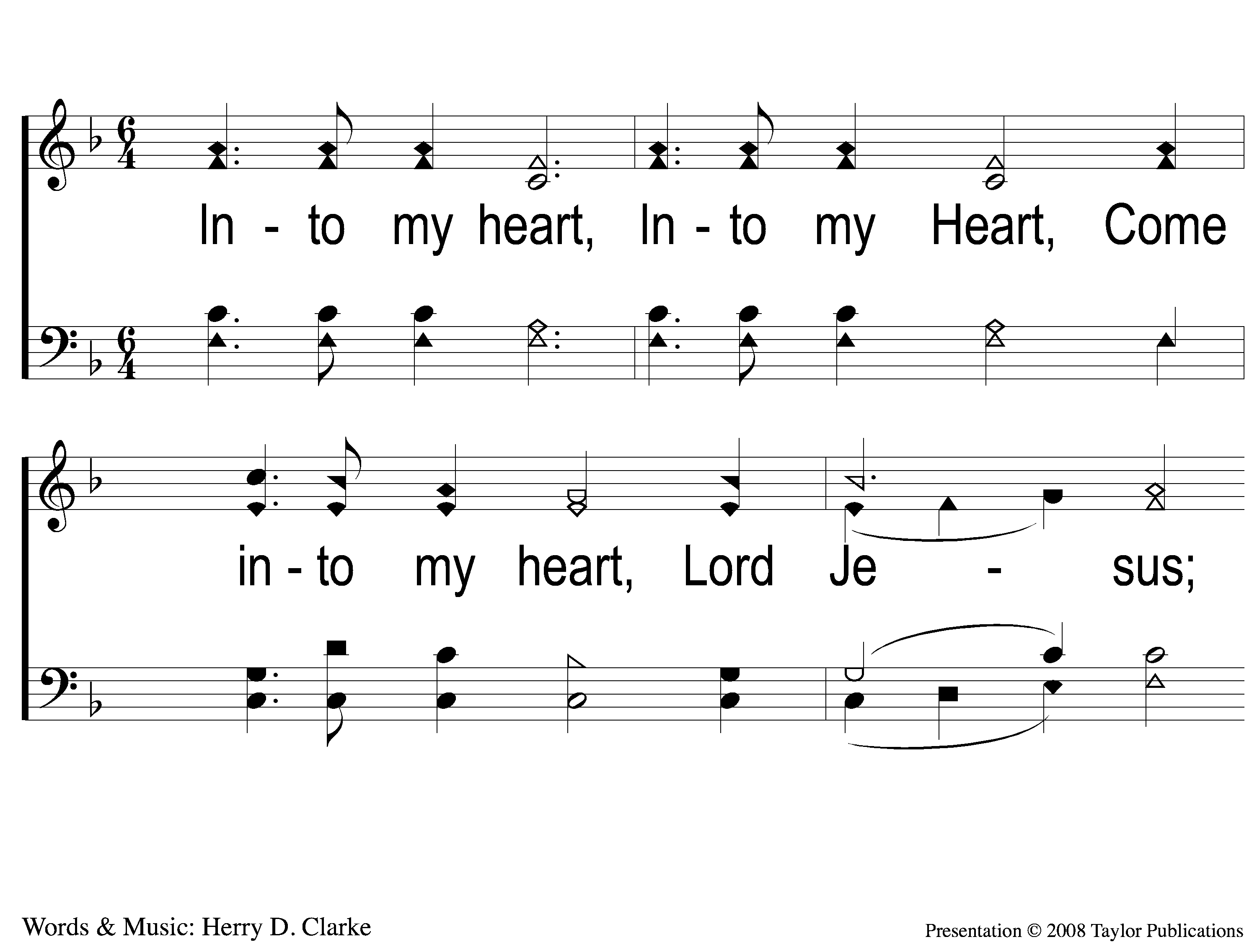
1 Into My Heart
Into My Heart
39b

Slide 2
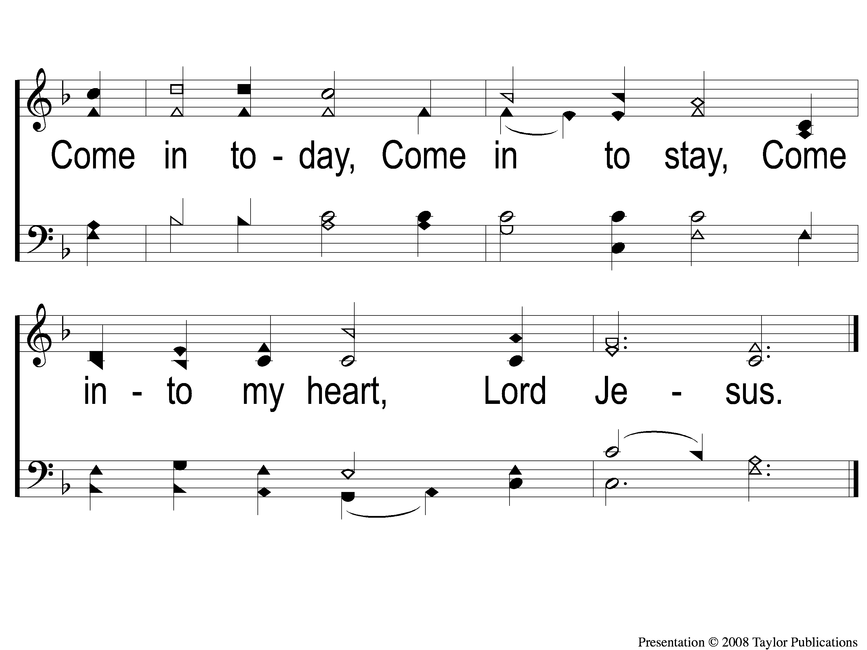
2 Into My Heart
Into My Heart
39b

